Slide 1

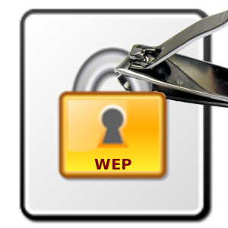

WEP
INGI2347: COMPUTER SYSTEM SECURITY (Spring 2014)
Marco Canini
Lecture slides adapted from UCL INGI2347 by Gildas Avoine, Upenn CSE331 by Steve Zdancewic, and Dan Boneh, Stanford Cryptography I@Coursera. Reproduced with permission
Notes:
Image source: http://ultimatepeter.com/wp-content/uploads/2013/12/wep.png

Slide 2
Announcements
2nd and 3rd challenge will be announced on 31 Mar
2nd challenge deadline: 23 Apr 23:59h
3rd challenge deadline: 7 May 23:59h

Slide 3
Plan for today
Lecture 9
Wireless Networks intrinsic
Authentication
WEP
Attacks on WEP
NEXT

Slide 4
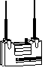
WiFi: Infrastructure Mode
Access points connect to wired network
Multiple mobile stations per Access Point
Wired network
Access Point (AP)
Mobile Devices

Slide 5

Problem: Eavesdropping
Wireless networking is just radio communications
Anyone with a radio interface can eavesdrop or inject traffic
Typical use inside: ~30m

Slide 6
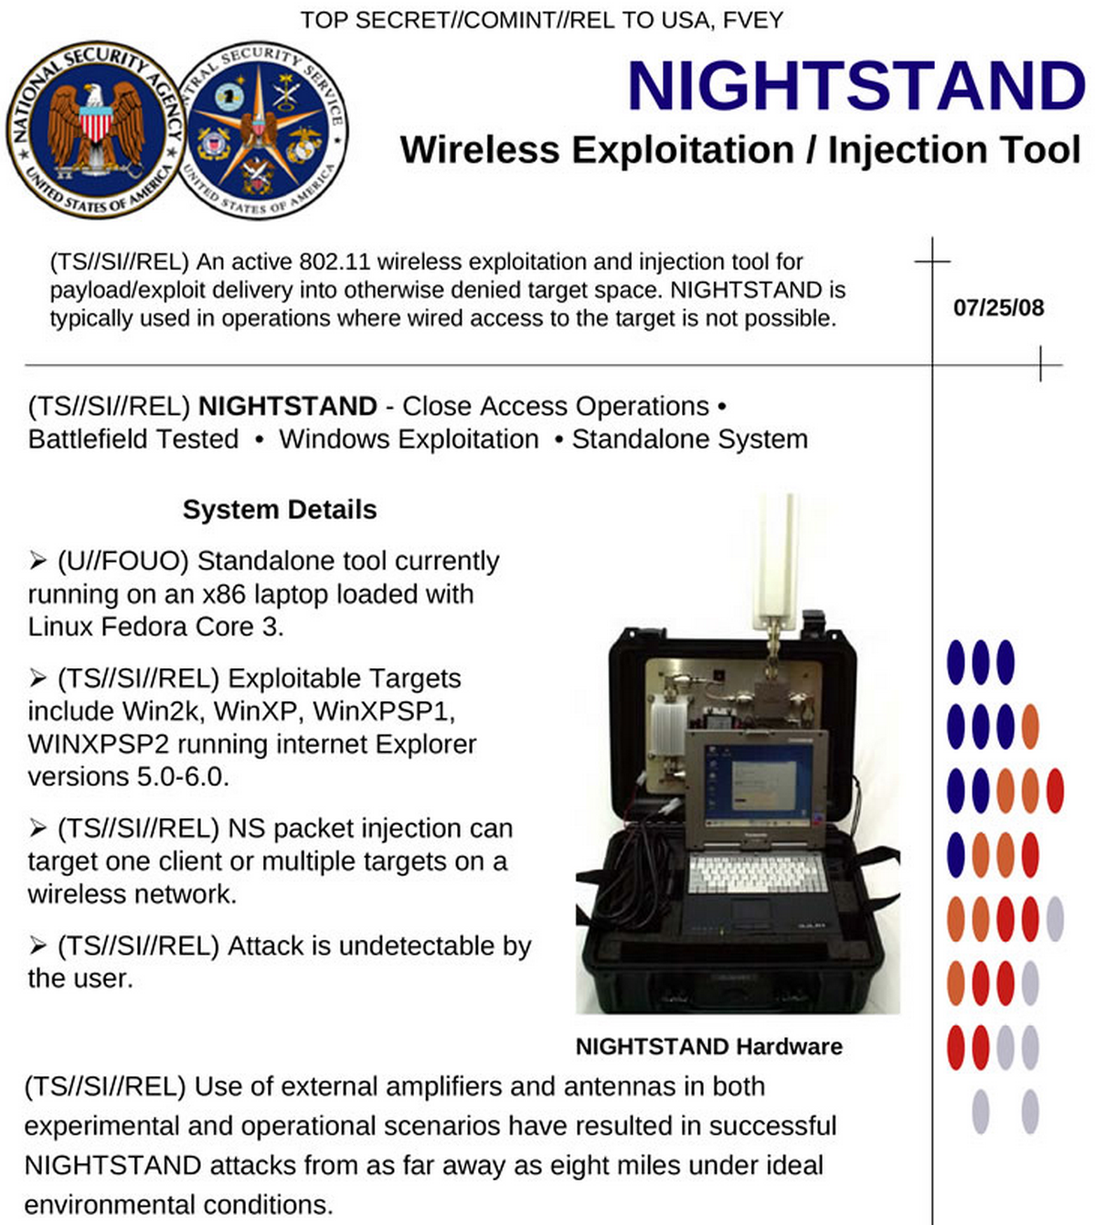
Outdoor too
Your friendly NSA can hack your WiFi over distances of up to 13 km
Notes:
Source: http://www.spiegel.de/international/world/a-941262.html

Slide 7

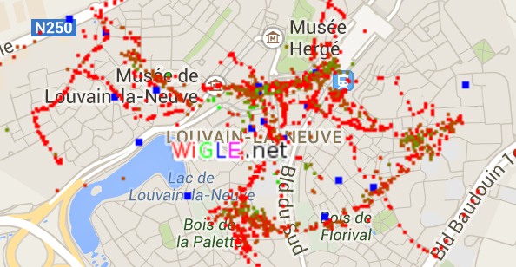
Wardriving
Discovering WiFi networks by a person in a car
No unauthorized access
To wardrive:
Laptop
802.11 adapter
Software
GPS
Car
While you drive, software logs all WiFi networks around
E.g. www.wigle.net

Slide 8
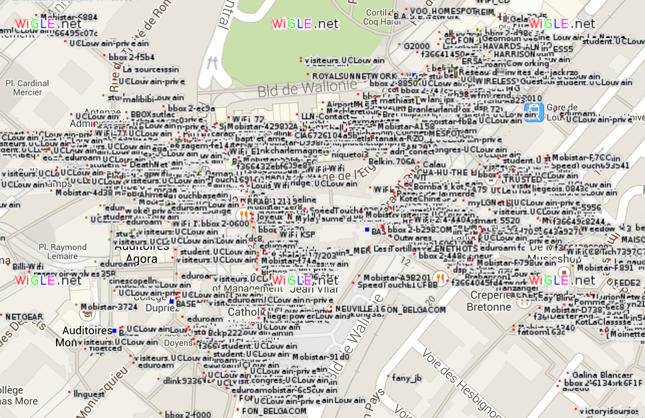
Example: LLN on WiGLE

Slide 9
Security Needs
Easiness to intervene on a wireless network
raises
security needs
Authentication
Integrity
Confidentiality

Slide 10
Authentication in WiFi networks
(in general)

Slide 11
Authentication options
Open systems
Do not broadcast AP’s SSID
MAC address filter
Cryptography (WEP, WPA, or WPA2)

Slide 12
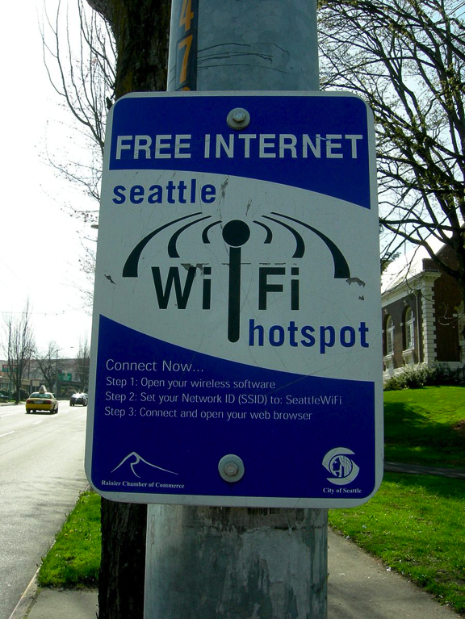
Open systems
No authentication at all
Less and less used?
Usually, providers impose authentication by default
Public free hot spots without authentication
Non-free hot spots in hotels, train stations, etc.
High Level Authentication (e.g. RADIUS Server)
Communities sharing their access
E.g. FON (Belgacom), VOO
Notes:
Source: http://en.wikipedia.org/wiki/File:Seattle_-_Columbia_City_WiFi.jpg

Slide 13
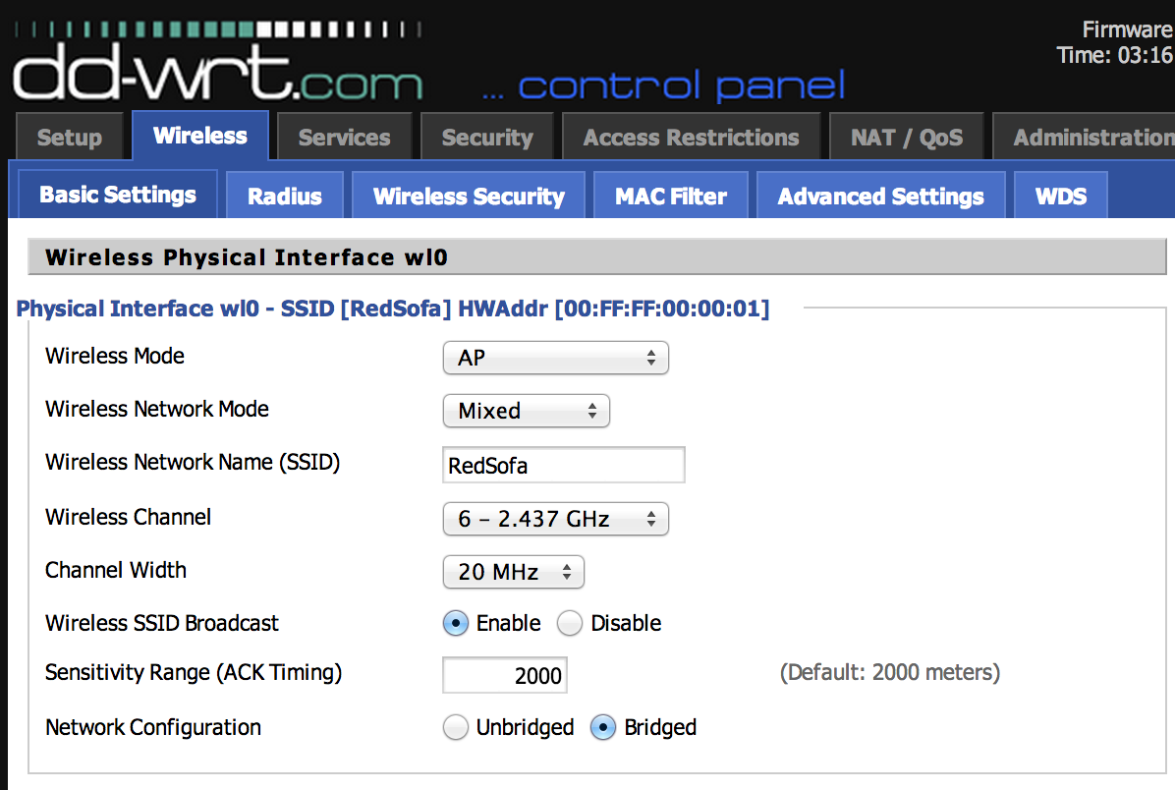
AP’s SSID
The AP broadcasts its SSID
Allow clients to dynamically discover the AP
SSID be used to authenticate a client
By avoiding broadcasting SSID
Client must know the SSID
Not secure because SSID can be eavesdropped
When a legitimate client connects

Slide 14
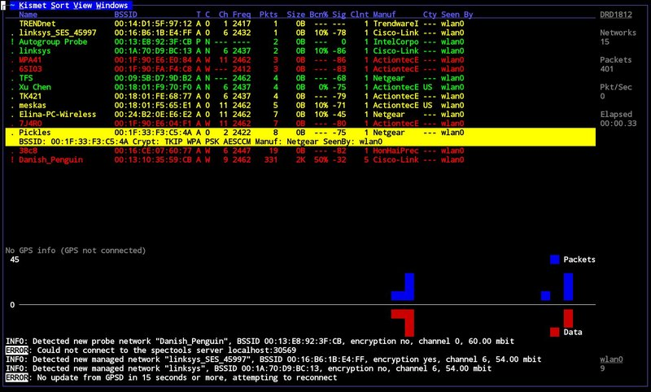
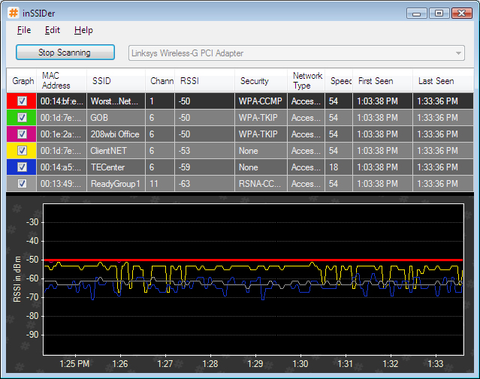
SSID in practice
Sniff the environment with e.g. Kismet, Airodump, Network Stumbler (Windows), inSSIDer, etc.

Slide 15
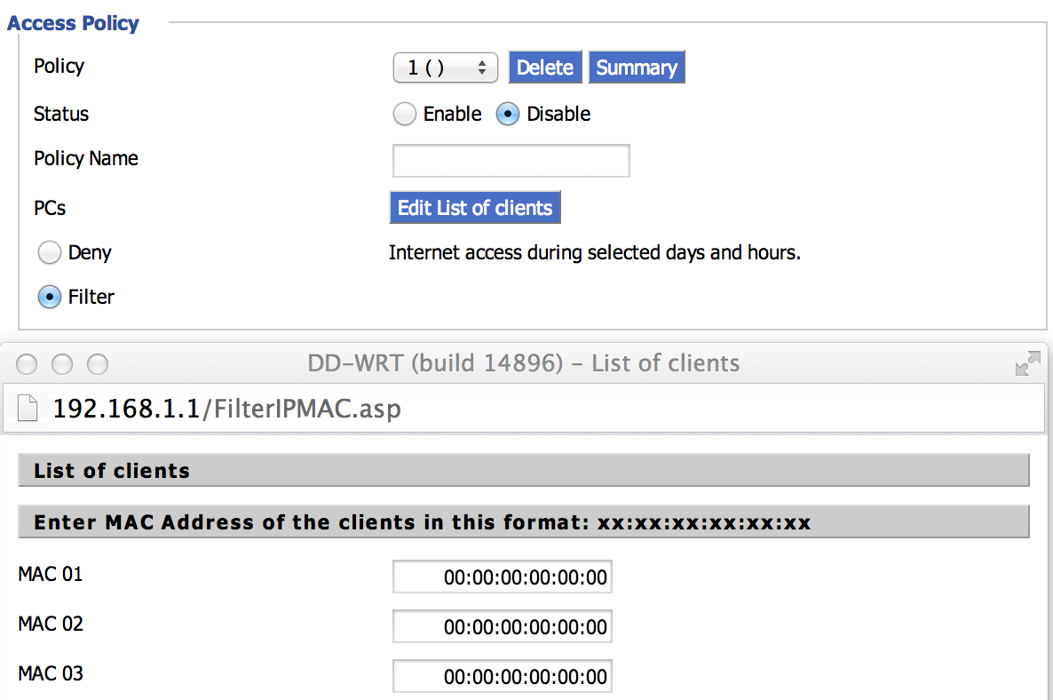
MAC address filter
AP stores a list of MAC addresses that are authorized to connect
Attacker can sniff the MAC address of a legitimate mobile station and steal it by replacing own MAC address with that MAC

Slide 16
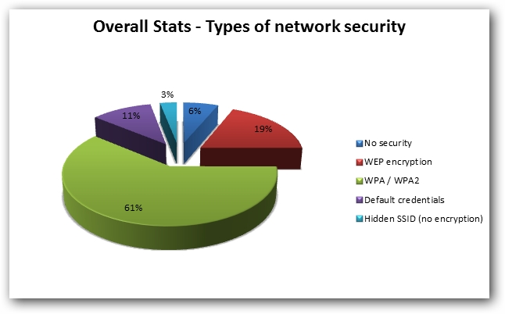
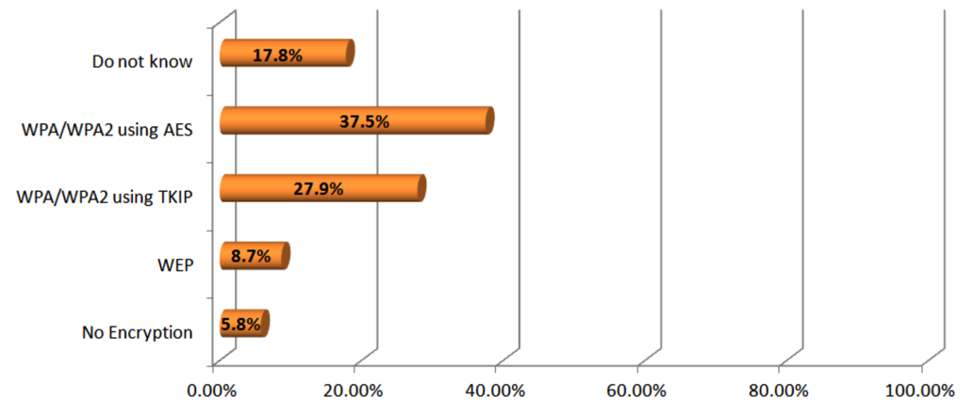
Encryption
Crypto: WEP or WPA
Prior to ~2010, very dire status: reports showed as low as 21-40% of the population using encryption
Status has been improving over the years… not quite 100% yet though
Why?
Study in Boston, Chicago, NYC, SF Bay Area, Seattle, Indiana. Source: ”WiFi Epidemiology: Can Your Neighbors’ Router Make Yours Sick?” H. Hu, S. Myers, V. Colizza, A. Vespignani, Feb 2008.
Source: http://www.hotforsecurity.com/blog/25-percent-of-wireless-networks-are-highly-vulnerable-to-hacking-attacks-wi-fi-security-survey-reveals-1174.html
Source: http://www.safewifi.hk/files/WiFi_Adoption_and_Security_Survey_2013.pdf

Slide 17
Wired Equivalent Privacy (WEP)

Slide 18
Wired Equivalent Privacy (WEP)
Part of 802.11 Standard (1999)
The stated goal of WEP is to make the wireless LAN as secure as a wired LAN
Features:
No key management
No protection against replay attacks
Authentication (“shared key” user authentication)
Confidentiality (RC4 stream cipher encryption)
Integrity checking (CRC-32 integrity mechanism)

Slide 19

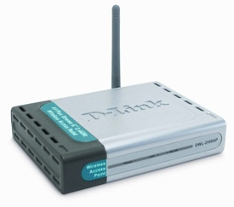
No Key Management
Every mobile station and AP has the same “pre-shared” key that is used during authentication and encryption
This key is distributed manually
Key A
Key A
Key A
Key A

Slide 20
No Key Management
In practice:
Key is loaded in device by hand when set up
Often keep manufacturer’s default
Printed under the router, in the user guide, etc.
Never updated again
Same key for everybody:
In large networks, users should have independent secure connections
Just a single non-honest WLAN user can break the security
Static key:
Since it is relatively easy to crack WEP encryption in a reasonably short time, keys should be changed often

Slide 21
Replay Attacks
Adversary can “replay” a packet she has already seen
Solutions?
Challenge-Response
Timestamp
Sequence Numbers

Slide 22
Integrity
Integrity is ensured using a CRC
CRC does not provide cryptographic integrity
CRC designed to detect random errors
Not designed to detect artificially-constructed changes

Slide 23
Encryption based on Stream Cipher
Plaintext
n bits
Stream Cipher
k bits
Keystream generator
n bits
Key
⊕
n bits
Ciphertext

Slide 24
The RC4 Stream Cipher
Designed by Ron Rivest (MIT) in 1987 for RSA Labs
Kept as a secret trade until 1994
Publicly disclosed in Sep 1994 on Cypherpunks mailing list
Bytes-oriented
Generate one keystream byte at each step
Efficient in software (compared to LFSRs, Block Ciphers)
Encryption in software is about 10 times faster that DES
Simple and elegant: based on XOR
Widely used:
Commercial software like MS Office, Oracle Secure SQL
Network protocols as SSL, IPsec, WEP
Copy protection: MS Xbox

Slide 25
RC4
Key scheduling:
Secret key of 1 to 256 bytes to initialize a 256-byte state table S
Keystream generation:
State table is used for subsequent generation of pseudo-random bytes
Key was limited to 40 bits, due to export restrictions but now RC4 is generally used with a 128-bit key

Slide 26
Key Scheduling (KSA)
Array K contains L bytes of key
L=16
K_{i} will denote K_{(i mod L)} in what follows
Array S always has a permutation of 0,1,…,N-1
N=2⁸
for i in 0 to N-1
S_{i} = i
// Initialization
j = 0
for i in 0 to N-1
j = (j + S_{i} + K_{i}) mod N
swap(S_{i}, S_{j})
// Scrambling

Slide 27
Keystream Generator (PRGA)
Each keystream byte is generated as follows:
i = (i + 1) mod N
j = (j + S_{i}) mod N
swap(S_{i}, S_{j})
output S_{(Si+Sj) mod N}
// Initially i = j = 0

Slide 28
Encryption based on Stream Cipher
Plaintext
checksum
IV prevents reuse of keystream
n bits
Stream Cipher
24 bits
Keystream generator
n bits
IV
Key
⊕
n bits
IV
Ciphertext
channel

Slide 29

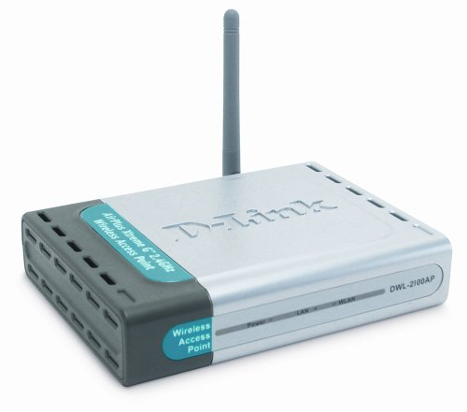
WEP Authentication
Authentication is successful, if WEP decryption gives original challenge text
MAC address
Challenge (128 bytes)
Response (encrypted)
Status code

Slide 30
Attacks on WEP

Slide 31
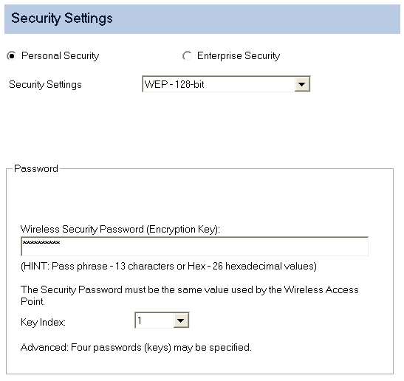
#1 Exhaustive Search
WEP uses 40-bit keys…
Due to exportation reasons
Easy to crack 40-bit keys in practice
40-bit key + 24-bit IV = 64 bits
Evolved version: 128 bits
104-bit key + 24-bit IV = 128 bits
13 characters or 26 hexs

Slide 32
#2 CRC Property
CRC is a linear function w.r.t. to XOR:
CRC(X ⊕ Y) = CRC(X) ⊕ CRC(Y)
Attacker observes (M || CRC(M)) ⊕ K where K is the keystream output
For any ΔM, the attacker can compute CRC(ΔM)
Hence, the attacker can compute:
([M || CRC(M]) ⊕ K) ⊕ [ΔM || CRC(ΔM)]
= ([M ⊕ ΔM) || (CRC(M) ⊕ CRC(ΔM)]) ⊕ K
= [(M ⊕ ΔM) || CRC(M ⊕ ΔM)] ⊕ K

Slide 33
#2 Example: ΔIP Address
If the attacker knows the destination IP address:
Attacker can change IP address in the ciphertext
And modify CRC so that it is correct
Then AP will decrypt and forward packet to the IP address selected by the attacker
Requires no knowledge of the key K

Slide 34
#3 Keystream Reused
WEP uses 24-bit (3 byte) IV
Each packet gets a new IV
RC4 packet key: IV pre-pended to long-term key K
If key and IV are same, then same keystream is used!

Slide 35
#3 Keystream Reused
Problem:
If K is never modified, IV is frequently repeated
IV is often a counter that starts at zero
Hence, rebooting causes IV reuse
Also, there are only 16 million possible values of IV, so after intercepting enough packets, they are sure to be repeated
There is a 50% chance of key-reuse after 2¹² packets (birthday paradox)

Slide 36
#3 Keystream Reused
If IV repeats, confidentiality is at risk:
If we send two ciphertexts (C, C’) using the same IV, then the XOR of plaintexts leaks (P ⊕ P’ = C ⊕ C’)
Reveal both P and P’ if there is enough redundancy
IV, P ⊕ RC4(K, IV)
IV, P’ ⊕ RC4(K, IV)

Slide 37
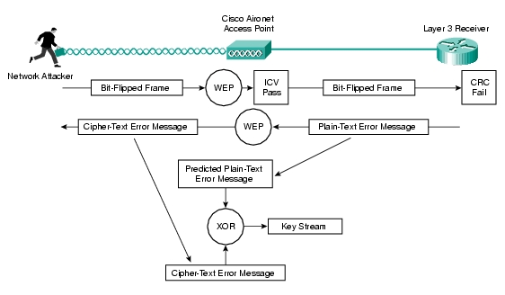
#3 Getting Some Plaintext
A bit-flipping attack is an attack on a cryptographic cipher in which the attacker can change the ciphertext in such a way as to result in a predictable change of the plaintext

Slide 38
Some history
1995 – Some security issues in RC4 (weak keys) – Roos, Wagner
2001 – The insecurity of 802.11 – Borisov, Goldberg, Wagner
2001 – Weaknesses in the key scheduling algorithm of RC4 – Fluhrer, Mantin, Shamir
2002 – Using the Fluhrer, Mantin, and Shamir Attack to Break WEP – Stubblefield, Ioannidis, Rubin
2004 – Korek, improves on the above technique and reduces the complexity of WEP cracking, proposing 17 attacks
2005 – Klein introduces more correlations between the RC4 key stream and the key
2007 – Tews, Weinmann, Pyshkin further simplify WEP Cracking

Slide 39
#4 Fluhrer, Mantin, and Shamir
2001, just 2 years after WEP was published
Some IVs are weak, i.e., they allow to guess some internal states, leading to the key
IV and first byte of plaintext/ciphertext must be known
IV is sent in the clear
Ciphertext is eavesdropped
First byte of plaintext can be easily guessed because it comes from the WEP SubNetwork Access Protocol (SNAP) header

Slide 40
WEP Cryptanalytic Attack
WEP data encrypted using RC4
Packet key is IV || K – IV (3 bytes) and key K
IV is sent in the clear (not secret)
New IV sent with every packet
Long-term key K never changed
Assume attacker knows IVs and ciphertext, and can guess the first bytes of the plaintext
Attacker wants to find the key K

Slide 41
WEP Cryptanalytic Attack
We denote the RC4 key bytes as:
K₀, K₁, K₂, K₃, K₄, K₅,…
Where IV = (K₀, K₁, K₂), which the attacker knows
Attacker wants to find K₃, K₄, K₅,…

Slide 42
RC4 Steps
KSA (Key-Scheduling Algorithm)
Initialization
Scrambling
PRGA (Pseudo-Random Generation Algorithm)

Slide 43
WEP Cryptanalytic Attack
for i in 0 to N-1
S_{i} = i
// Initialization
i | 0 | 1 | 2 | 3 | 4 | 5 | 6 | …
S_{i} | 0 | 1 | 2 | 3 | 4 | 5 | 6 | …

Slide 44
WEP Cryptanalytic Attack
j = 0
for i in 0 to N-1
j = (j + S_{i} + K_{i}) mod N
swap(S_{i}, S_{j})
// Scrambling
i | 0 | 1 | 2 | 3 | …
K_{i} | 4 | 8 | 242 | 254 | …
Example of key
i | 0 | 1 | 2 | 3 | 4 | … | … | N-1
S_{i} | 0 | 1 | 2 | 3 | 4 | … | … | N-1
initial S
i=0, j=0+S₀+K₀=4
S_{i} | 4 | 1 | 2 | 3 | 0 | … | … | N-1
i=1, j=4+S₁+K₁=4+1+8=13
S_{i} | 4 | 13 | 2 | 3 | 0 | … | … | N-1
Example from “Break WEP Faster with Statistical Analysis”, by Rafik Chaabouni, 2006

Slide 45
WEP Cryptanalytic Attack
i = (i + 1) mod N
j = (j + S_{i}) mod N
swap(S_{i}, S_{j})
output S_{(Si+Sj) mod N}
// Initially i = j = 0
i | 0 | 1 | 2 | 3 | …
K_{i} | 4 | 8 | 242 | 254 | …
Example of key
i | 0 | 1 | 2 | 3 | 4 | 5 | … | N-1
S_{i} | 4 | 2 | 3 | 13 | 43 | 7 | … | N-1
After KSA (Assumption)
i=1, j=0+2=2
S_{i} | 4 | 3 | 2 | 13 | 43 | 7 | … | N-1
First outputted byte is S_{(S1+S2)}=S₍₃₊₂₎=S₅=7

Slide 46
WEP Cryptanalytic Attack
Attack due to Fluhrer, Mantin, and Shamir
Attacker watches IVs until seeing IV of the form: IV = (K₀, K₁, K₂) = (3, 255, X)
Where X can be anything (attacker knows X)
Then RC4 key for this packet is key = (3, 255, X, K₃, K₄, K₅, …)
Attacker wants to find (K₃, K₄, K₅, …)

Slide 47
WEP Cryptanalytic Attack
j = 0
for i in 0 to N-1
j = (j + S_{i} + K_{i}) mod N
swap(S_{i}, S_{j})
// Scrambling
i | 0 | 1 | 2 | 3 | 4 | …
K_{i} | 3 | 255 | X | K₃ | K₄ | …
 | i\S | 0 | 1 | 2 | 3 | 4 | … | 5+X | … | 6+X+K₃ | …
_{initial state} | init | 0 | 1 | 2 | 3 | 4 | … | 5+X | … | 6+X+K₃ | …
i=0, j=0+S₀+K₀=0+0+3=3 | i=0 | 3 | 1 | 2 | 0 | 4 | … | 5+X | … | 6+X+K₃ | …
i=1, j=3+S₁+K₁=3+1+255=3[N] | i=1 | 3 | 0 | 2 | 1 | 4 | … | 5+X | … | 6+X+K₃ | …
i=2, j=3+S₂+K₂=3+2+X=5+X | i=2 | 3 | 0 | 5+X | 1 | 4 | … | 2 | … | 6+X+K₃ | …
i=3, j=(5+X)+(1)+K₃=6+X+K₃ | i=3 | 3 | 0 | 5+X | 6+X+K₃ | 4 | … | 2 | … | 1 | …

Slide 48
WEP Cryptanalytic Attack
So far we have only considered the first 4 steps of initialization, i = 0,1,2,3
In reality, there are 256 steps
For now, assume that initialization stops after i = 3
So, the keystream outputted by PRGA is:
i = (i + 1) mod N
j = (j + S_{i}) mod N
swap(S_{i}, S_{j})
output S_{(Si+Sj) mod N}
= 1
= S₁ = 0
swap(S₁, S₀)
output S₃ = 6+X+K₃
// Initially i = j = 0

Slide 49
WEP Cryptanalytic Attack
Keystream byte Y= 6+X+K₃
If Y is known, we can solve for K₃ since:
K₃ = (Y6X) mod N
But initialization does not stop at i=3 …
So can this “attack” really work?
If elements at 0,1 and 3 are not swapped in remaining initialization steps, attack works!

Slide 50
WEP Cryptanalytic Attack
For remaining initialization steps…
We have i=4,5,6,… so index i will not affect anything at indices 0,1 or 3
But what about index j?
Pretend index j selected at random
At each step, probability is 253/256 that j  {0,1,3}
There are 252 steps after i=3
Probability that 0,1 and 3 are not affected by index j after step i=3 is
(253/256)²⁵² = 0.0513

Slide 51
WEP Cryptanalytic Attack
Can the attacker really recover the key?
After seeing enough IVs can obtain K₃
Suppose attacker got K₃
How to find K₄?
Consider IVs of the form: IV = (4, 255, X).
Then after initialization step i=4, one can show that:
Keystream byte Y = S₄ = 10+X+K₃+K₄

Slide 52
WEP Cryptanalytic Attack
If enough IVs are available
And corresponding 1st keystream bytes are known
Then attacker can recover the key
Find K₃ then K₄ then K₅ and so on…
Get entire key, regardless of length

Slide 53
WEP Cryptanalytic Attack
4 million IVs to recover a 128-bit key
Number of IVs is linear with the key-length
(vs exponential)
Key is revealed sequentially byte after byte

Slide 54
Further Attacks
Korek – 2004
Proposed 17 attacks based on FMS
New classes of weak IVs
1 million IVs
Tews, Weinmann, Pyshkin (PTW) – 2007
Still new classes
80,000 IVs
Variant by Vaudenay/Vuagnoux 2007 (32,000 IVs)
Key bytes are no longer necessarily guessed sequentially

Slide 55
Downloadable Tools
AirCrack-ng
http://www.aircrack-ng.org
Implement Korek, PTW (needs ARP flooding)
WepCrack
http://sourceforge.net/projects/wepcrack/
“WEPCrack is a tool that cracks 802.11 WEP encryption keys using the latest discovered weakness of RC4 key scheduling”
Last version: Oct 2004
AirSnort
http://airsnort.shmoo.com/
Last update: 2005 (no longer supported)
Implement Korek’s attacks

Slide 56
Any questions?

Slide 57

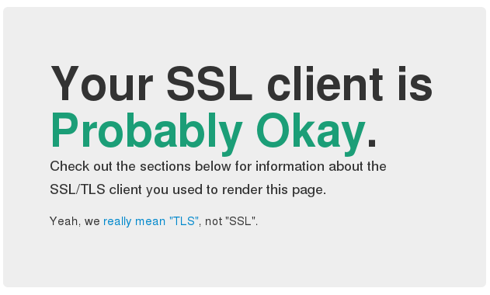
WPA | SSL/TLS
Stay tuned
Next time you will learn about
Notes:
Source: http://2.bp.blogspot.com/-M8oKe2_nLFQ/TyqaGyrOVcI/AAAAAAAAA1U/MJUJDGRGewo/s1600/wpa+secure.jpg | https://blog.dbrgn.ch/images/2014/1/ssl_ok.png

